Slide 1
Private Cloud
Trainer – Manish Jain

Slide 2
Session Plan
Private Cloud
Private Cloud Overview
Private Cloud Architecture
Advantage of Private cloud
Limitations of Private cloud
UEC – How to Build Private Cloud
Eucalyptus in Private Cloud

Slide 3

Private cloud

Slide 4
Private Cloud
Private cloud is a technology which has the potential to host applications and server or storage space in your own dedicated datacenter and provision access to these resources on demand.

Slide 5
Private Cloud Infrastructure
In a private Cloud Infrastructure we can deploy new applications, virtual servers and storage in minutes where the legacy IT models that took ages to cater the requirements, by getting the budget approved, selecting the best quote and get the server delivered and deployed to the end user.

Slide 6
Private Cloud Objective
The prime objective of going for Cloud Solution is to lower the server administration cost, optimize the usage of server hardware, and to reduce power consumption in data center.
The private cloud provides an effective way for the smooth deployment, management and usage of VMs, applications and other IT Infra resources on hardware that’s dedicated to a single organization.

Slide 7
Use cases where private clouds are of particular interest
1. A private cloud offers a company the ability to quickly develop and prototype cloud aware applications behind the firewall. This includes the development of privacy sensitive applications such as credit card processing, medical record database, classified data handling, etc.

Slide 8
Use cases where private clouds are of particular interest
2. High-performance applications whose load varies over time will benefit from being run on a platform that is “elastic”. Instead of having your IT infrastructure built for the sum of all the peak loads of different application, you can build a cloud infrastructure for the aggregated peak load at a single point in time instead. Furthermore opportunities exist to burst from a private cloud to a public environment in times of peak load.

Slide 9
Use cases where private clouds are of particular interest
3. Self-Service IT: Using a private cloud technology, organizations can now put together a pool of hardware inside the firewall, a set of standard base images that should be used, and provide a simple web interface for their internal users to create instances on the fly. This should maximise the speed of development and testing of new services whilst reducing the backlog on IT.

Slide 10
Creating and maintaining a private cloud based services
Ubuntu Enterprise Cloud (UEC)
Eucalyptus
A middleware that supports cloud based services being offered over network.

Slide 11
Ubuntu Enterprise Cloud (UEC)
Ubuntu is the only Linux distribution to position itself as a true cloud OS with three initial components of our cloud strategy already released. Two of these components are aimed at the infrastructure layer of the computing stack (commonly called IaaS or Infrastructure as a Service) while one component is aimed at the software layer (commonly called SaaS)
The three components are known as:
• Ubuntu Server Edition on Amazon EC2 (IaaS)
• Ubuntu Enterprise Cloud powered by Eucalyptus (IaaS)
• UbuntuOne (SaaS)

Slide 12
Eucalyptus
Eucalyptus stands for Elastic Computing Architecture for Linking Your Programs to Useful Systems.
It is an Open source Linux-based software framework for the implementation of private cloud computing on computer clusters. Private clouds give users access to computing resources hosted within the infrastructure of an organization.
Stable Release – 2.0.2

Slide 13
UEC elements
The architecture of Eucalyptus, which is the main component of UEC, has been designed as modular set of 5 simple elements that can be easily scaled:
• Cloud Controller (CLC)
• Walrus Storage Controller (WS3)
• Elastic Block Storage Controller (EBSC)
• Cluster Controller (CC)
• Node Controller (NC)
Each element is acting as an independent web service that exposes Web Service Description Language (WSDL) document defining the API to interact with it.

Slide 14
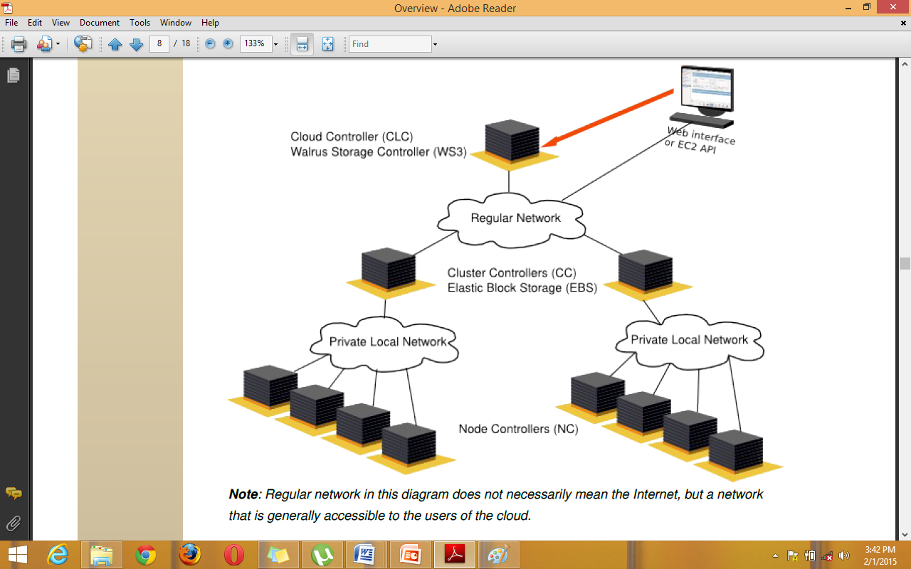
Web Services Architecture

Slide 15
Cloud Controller
It is written in Java. It has EC2-compatible SOAP and Query interfaces. Apart from that, it also has a Web interface. It executes on the front-end.
It is a collection of web services - Resource Services, Data Services, Interface Services.
Resource services have detailed information about the availability of resources (like nodes used for provisioning the instances) and usage of resources (which clusters will be given for provisioning the instances).
Users can query the Data services to discover resource information (images and clusters).
Using the Interface Services through the Web Browser, users can download cryptographic credentials needed to query the system and the administrators can manage user accounts.

Slide 16
Walrus Storage Controller
It is written in Java. It has S3-compatible SOAP and REST interfaces.
It executes on the front-end. It is a storage service for uploading VM images (kernel and ramdisk images).

Slide 17
Elastic Block Storage Controller
It is written in Java. Its functionality is similar to Amazon's EBS functionality.
It executes on head node of the cluster. Head node is that machine which is connected to the nodes as well as the CLC.

Slide 18
Cluster Controller
It is a C program.
It executes on head node of the cluster.
It schedules instance run requests to specific NCs, controls the virtual network overlay, calculates the no of instances that can run on NCs and reports this to CLC.

Slide 19
Node Controller
It is a C program.
It executes on every node designated for hosting VM instances.
It receives queries from CC about resources and queries system software on the node to discover the no of cores, size of memory and available disk space. It then propagates this information to CC.
It also receives requests from CC about VM and instructs the hypervisor to boot the VM, terminate the VM etc.

Slide 20
Details of ports and processes
8443 is used for the Web Interface
8773 is used by the CLC
8774 is used by the CC
8775 is used by the NC
9001 is used by SC and Walrus
Walrus uses a HSQL database to store all metadata about buckets stored on system

Slide 21
Virtual Network Overlay
Every VM must have network connectivity to each other. And, atleast one VM instance must have network connectivity to the public network, so that, instance set owner can log in to another system on the network and interact with his instance.
Virtual Network Overlay is controlled by the CC. It handles the set up and tear down of VMs’ network interfaces in 3 admin defined modes:
System
Static
Managed

Slide 22
Virtualization
A virtual machine (VM) is a software implementation of a machine (i.e., a computer) that executes programs like a physical machine. A hypervisor provides a uniform abstraction of the underlying physical machine.
Multiple VMs can execute simultaneously on a single hypervisor. Eucalyptus deploys instances (i.e., virtual machines) on a hypervisor.
Eucalyptus can use either xen or kvm hypervisors. To interact with them, Eucalyptus employs libvirt virtualization API.

Slide 23
Euca2ools
These are command-line tools for interacting with Web services that export a Query-based API compatible with Amazon EC2 and S3 services.
They help in querying availability zones, managing ssh keys, managing images etc.

Slide 24
Prerequisites to set up Eucalyptus Cloud
For a minimal cloud infrastructure, at least two systems are needed:
a Front End
CLC , Walrus, CC , SC execute on the front-end
a Node
NC executes on the node

Slide 25
UEC Eucalyptus Lab Practicals
Verify configuration requirements and Plan
UEC Install
Packages Install/Manage
Boot Loader Configuration
Eucalyptus Configuration
CC
Virtualization Data Management
Eucalyptus Configuration/Discussions

